Slide 1


Statistic
Lecture 8
Dr. Nada Abdullah Rasheed
Assist prof. / Computer Science

Slide 2
Syllabus Content
Subject | Lec. No.
Calculating the Slope Coefficient (b₀) | 3
Calculating the Intercept Coefficient (b₀) | 7
Plotting a Regression Line | 9
Making Inferences about Regression Equations and Coefficients | 10

Slide 3
Regression
6.3 Calculating the Slope Coefficient (b₀)
The most important thing to keep in mind when calculating the slope and intercept in a regression equation is which variable you are regressing on the other, that is, which variable is being used to predict values of the other? The data from Chapter 15 are presented to the right where the correlation was calculated between age (X) and the number of books a person reads per month (Y). The descriptive statistics for each variable as are the summary statistics.

Slide 4
Regression
Name | Age (X) | Books per Month (Y)
A | 22 | 8
B | 20 | 4
C | 22 | 4
D | 21 | 3
E | 35 | 6
F | 32 | 7
G | 38 | 4
H | 40 | 6
I | 20 | 3
J | 40 | 5
n = 10 | ∑X = 290 | ∑Y = 50
 | M_{X} = 29 | M_{Y} = 5
SCP = 43 | SS_{X} = 647 | SS_{Y} = 26
cov = 4.778 | sX2=71.889 | sY2=2.889
r = 0.331 | sX=8.479 | sY=1.7

Slide 5
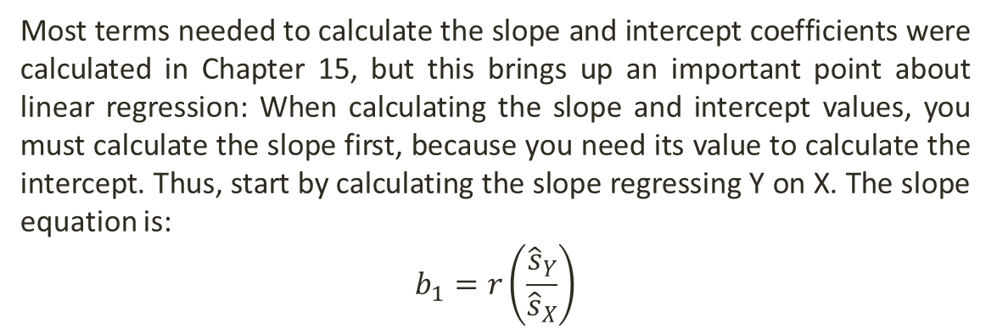
Regression
We want to fit a linear regression equation to these data to model the number of books a person reads per month based on age. Hence, we want to generate a regression equation to predict the number of books read per month from age.
Most terms needed to calculate the slope and intercept coefficients were calculated in Chapter 15, but this brings up an important point about linear regression: When calculating the slope and intercept values, you must calculate the slope first, because you need its value to calculate the intercept. Thus, start by calculating the slope regressing Y on X. The slope equation is:
$$b_{1}=r\left(\frac{{\hat{s}}_{Y}}{{\hat{s}}_{X}}\right)$$

Slide 6
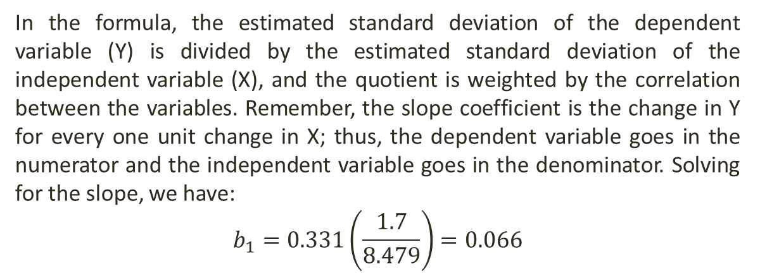
Regression
In the formula, the estimated standard deviation of the dependent variable (Y) is divided by the estimated standard deviation of the independent variable (X), and the quotient is weighted by the correlation between the variables. Remember, the slope coefficient is the change in Y for every one unit change in X; thus, the dependent variable goes in the numerator and the independent variable goes in the denominator. Solving for the slope, we have:
$$b_{1}=0.331\left(\frac{1.7}{8.479}\right)=0.066$$

Slide 7
Regression
6.4 Calculating the Intercept Coefficient (b₀)
Once you have calculated the slope you can calculate the intercept (b₀). The equation is actually a variant of the regression equation that has been rewritten to solve for a:
In this equation, you must determine the mean of Y, which is the mean of the regressed/predicted variable, and the mean of X, which is the mean of the independent variable. From the data in the table above, and . Plugging these values into the equation

Slide 8
Regression
This value (b₀ = 3.086) is the intercept in the regression equation, that is, the predicted value of Y when X = 0. Now that you have solved for the slope and intercept you can write out the regression equation by inserting the values of b₀ and b₁ into the generic regression equation from before:
You can use this equation to solve for predicted values of Y by plugging in any possible value of X and solving for Y', which we will do in the following section.

Slide 9
Regression
6.5 Plotting a Regression Line
The regression equation is the model of a straight line through the data points for two variables. Hence, we can plot the function (regression equation) in a scatterplot with the data. There are two ways you can do this: (1) Select a small value of X to compute a predicted value of Y and select a large value of X to predict a second value of Y.
Plot both X-Y' data points in the scatterplot and join them by a straight line. (2) Compute each Y' value corresponding to each known X-value, plot each X-Y' data point in the scatterplot and draw a line through all of them.

Slide 10
Regression
Name | Age (X) | Books (Y) | Y' = 3.086 + 0.066X | Y’
A | 22 | 8 | 3.086 + .066(22) | 4.538
B | 20 | 4 | 3.086 + .066(20) | 4.406
C | 22 | 4 | 3.086 + .066(22) | 4.538
D | 21 | 3 | 3.086 + .066(21) | 4.472
E | 35 | 6 | 3.086 + .066(35) | 5.396
F | 32 | 7 | 3.086 + .066(32) | 5.198
G | 38 | 4 | 3.086 + .066(38) | 5.594
H | 40 | 6 | 3.086 + .066(40) | 5.726
I | 20 | 3 | 3.086 + .066(20) | 4.406
J | 40 | 5 | 3.086 + .066(40) | 5.726

Slide 11
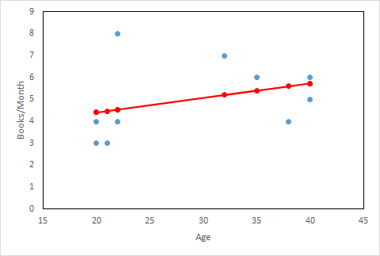
Regression
Plotting the X - Y' data points in a scatterplot with the actual X-Y data points, we get the graph below. In the scatterplot, the actual X-Y data points are plotted in blue and the X-Y' data points are plotted in red with a line passing through them. This is the ‘best fit’ linear relationship between age (X) and number of books read per month (Y). Again, notice that the Y' values differ from the actual Y values. Again, with an imperfect linear relationship, this is to be expected. The differences between the Y values and predicted Y' values is residual variance, which we will turn to in the next section.

Slide 12

Regression
6.8 Making Inferences about Regression Equations and Coefficients
There are tests of statistical significance for regression coefficients (intercept and slope) and for the entire regression equation. There are several things that can be significant in any regression equation: First, the entire regression equation can be a significant model of a linear relationship. Second, the slope (b₁) can be a significant predictor for changes in Y. Finally, the intercept (b₀) can be significant (which is usually assumed to be zero under the null). Instead of burrowing into the various assumptions and population distributions about the slope, intercept and regression equation, I’ll focus more on how significance is determined for the regression equation and components that we calculated in earlier sections.
Recall that the regression equation that predicted number of books read per month (Y) from age (X) was:

